Slide 1



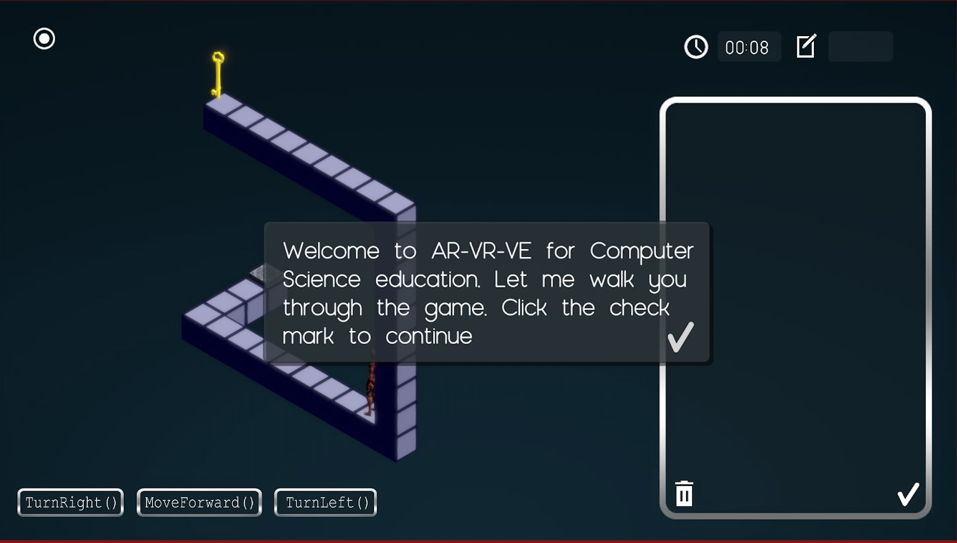
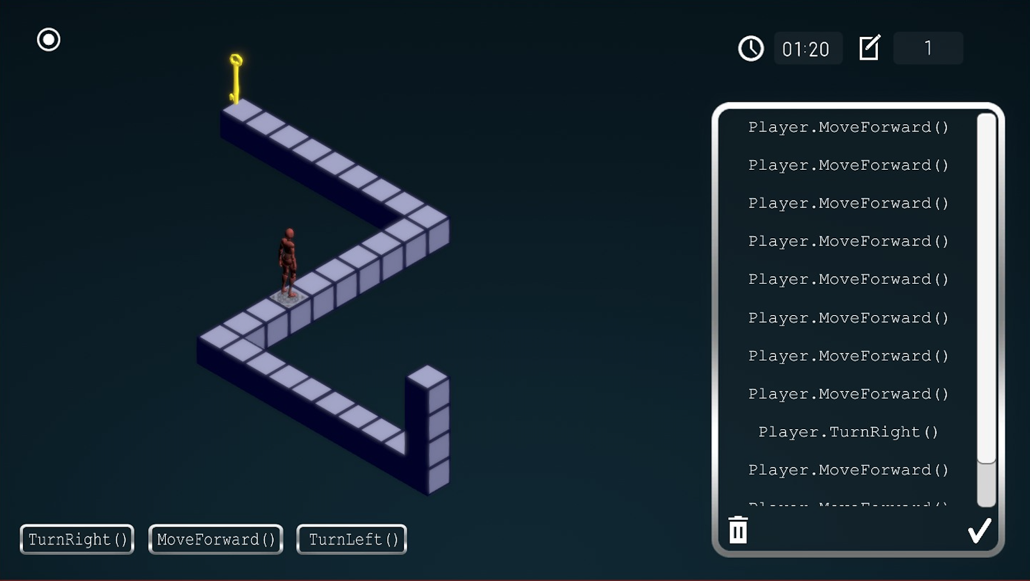
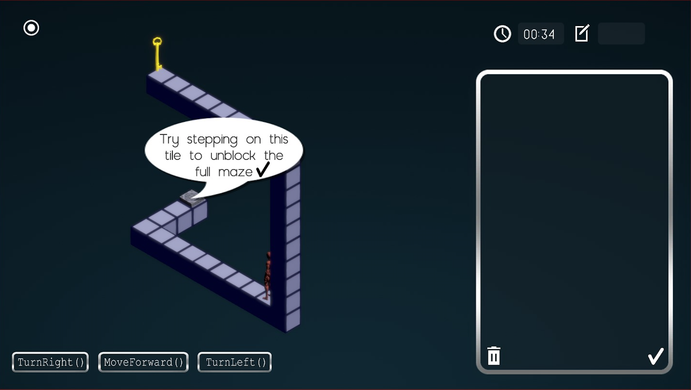
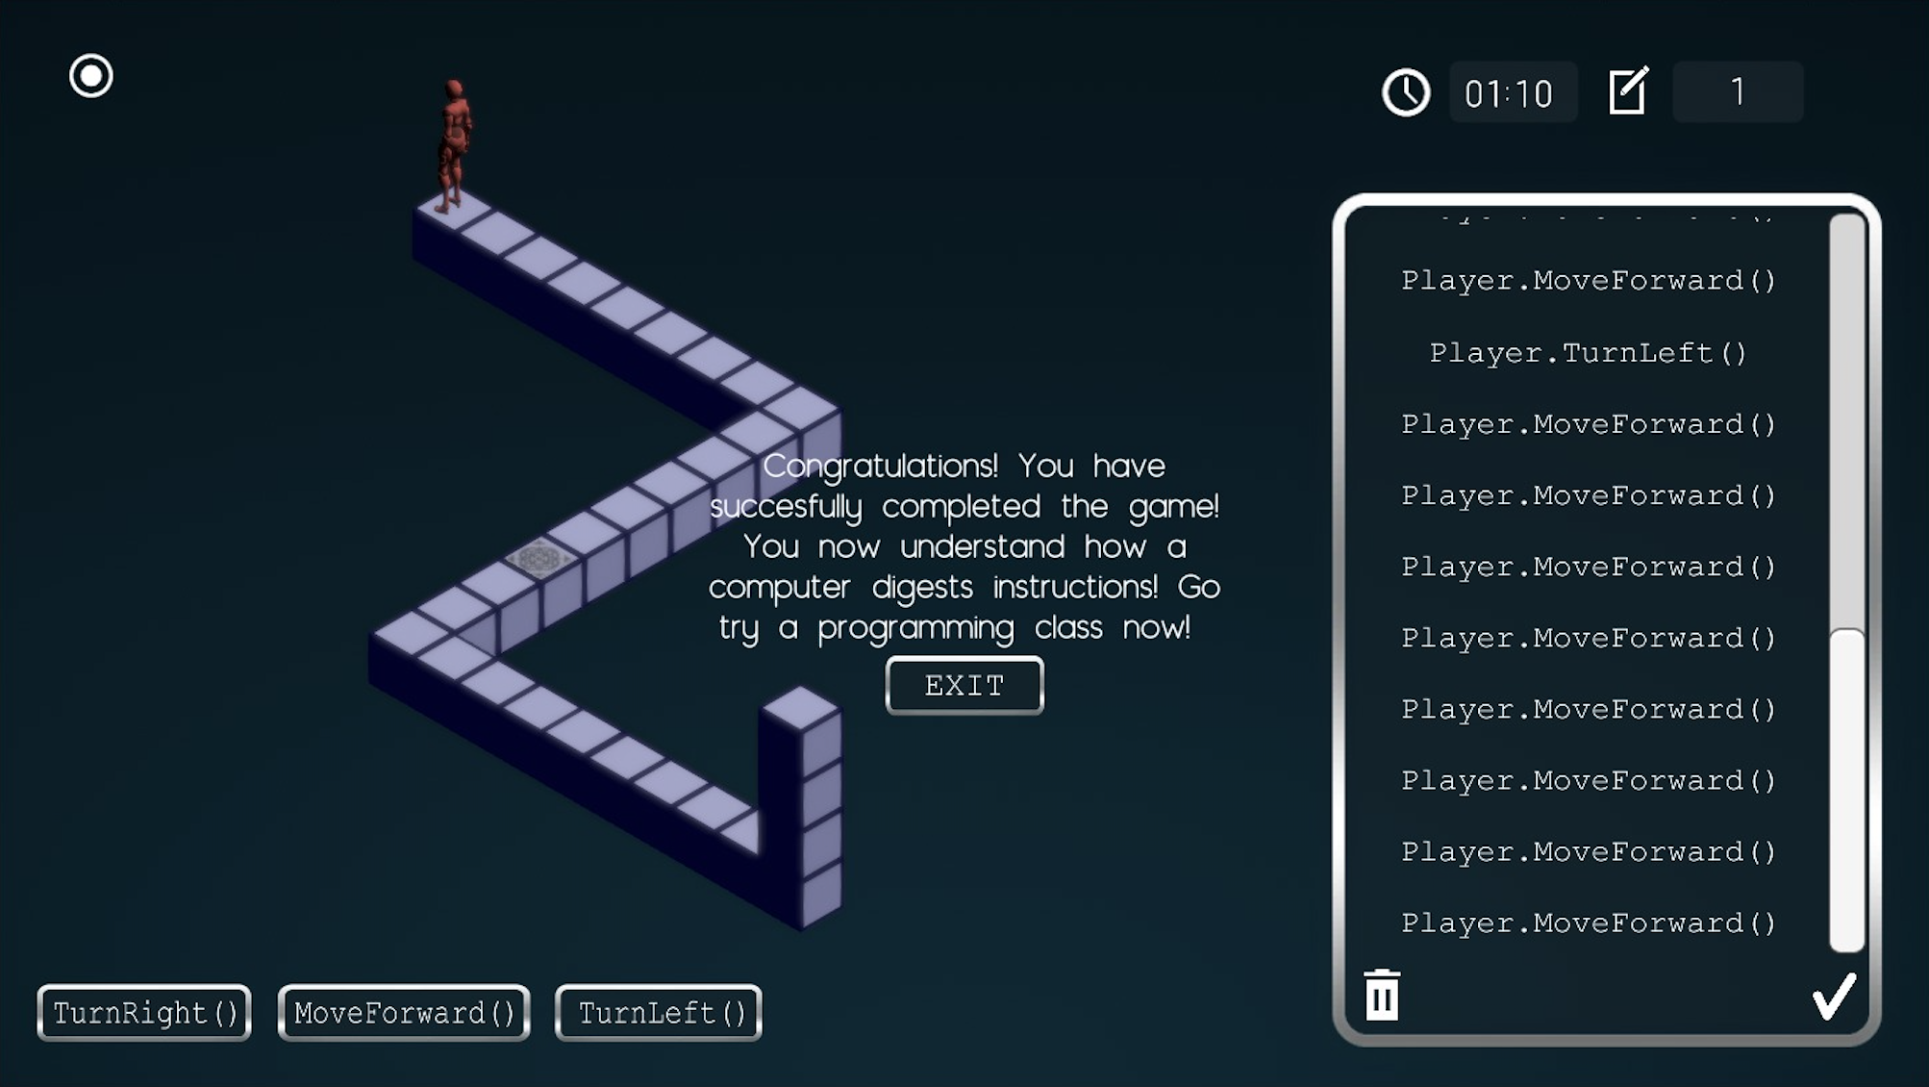
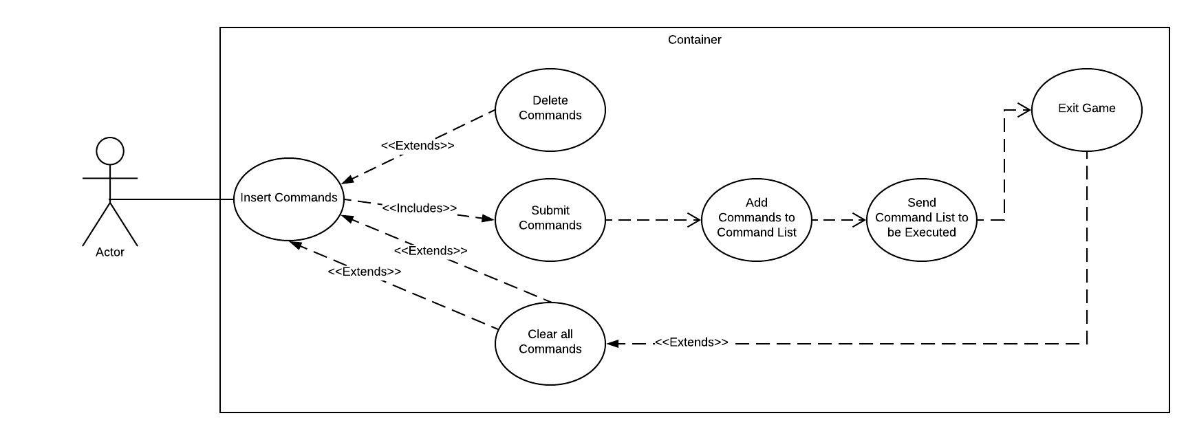
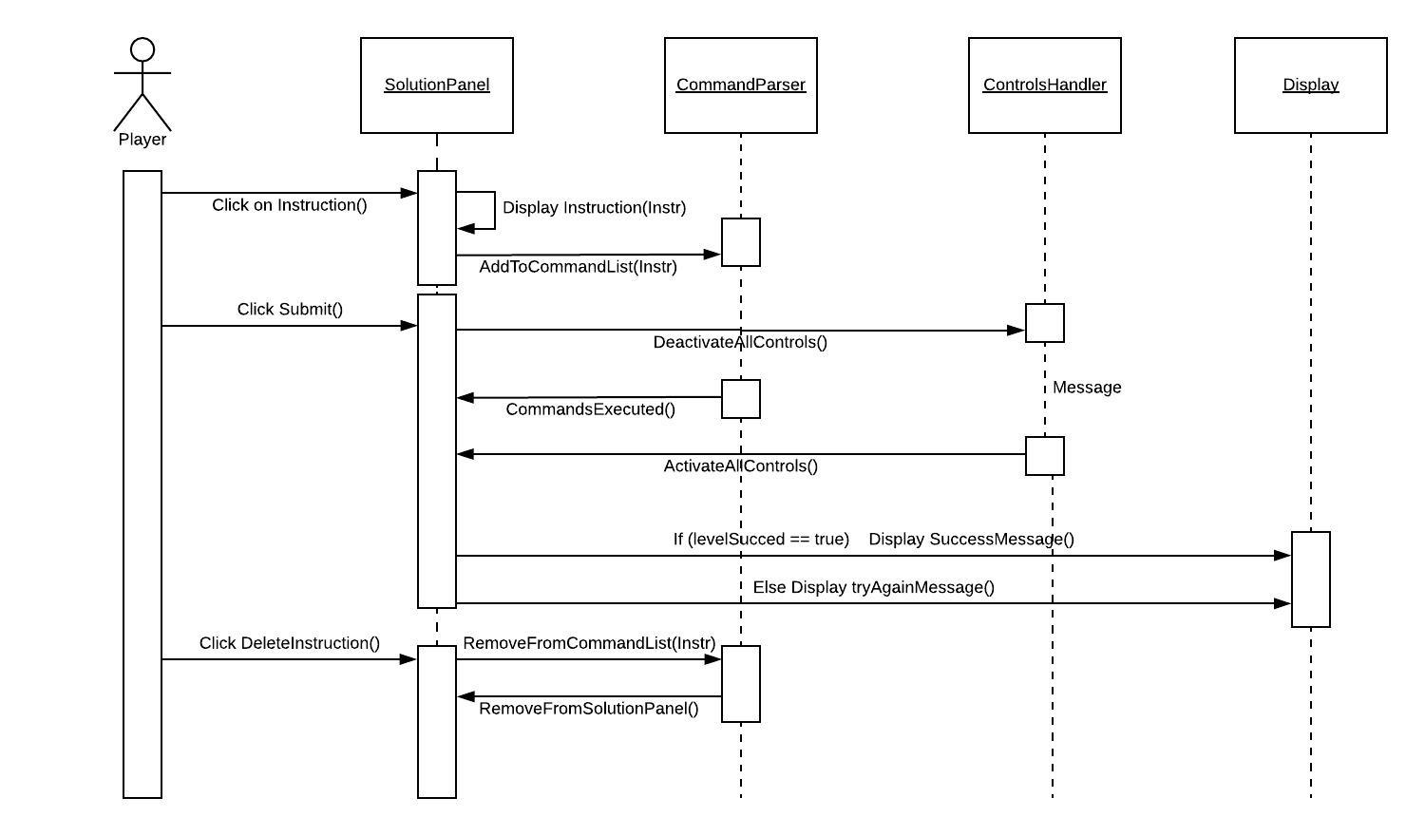
VIP Senior Project , Spring 2018
AR-VR-VE For Computer Science Education 1.0
Student: Mairim Barrios, Florida International University
Mentor: Dr. Francisco Ortega, School of Computing and Information Sciences
Professor: Dr. Francisco Ortega & Dr. Masoud Sadjadi, Florida International University
Problem
The gender gap in Computer Science has gotten worse in the last 30 years, even as computer science job opportunities expand rapidly. Some of the factors that impact the number of women abstaining from pursuing a computing discipline include, programming not portrayed as enjoyable but instead overly complex and the recursive problem of few to none females studying computing.
Solution
To decrease the gender gap in CS we must bring in more females into this discipline by demonstrating that CS is enjoyable, A desktop game has been developed that teaches the core principle behind computer programming. The design and functionality of the User Interface was key to making the user’s learning experience meaningful and enjoyable.
Current System
This is version 1.0 of this desktop game. However, the previous concept that aimed to increase interest in Computer Science created a set of educational activities for students to use in Mixed-Reality, through the use of virtual buttons.
Screenshots
Requirements
User is able to add instructions into the solution panel, and can easily remove them from there as well.
User controls are carefully enabled/disabled to avoid any bad input and unwanted crashes in the game.
The user understands the concepts and directions of the game from the initial tips.
User interface layout is easy to understand and helps in making the game an enjoyable experience.
System Design and Implementation
OS: Windows and Mac
Unity Game Engine
C# For Scripts
Git for Version Control
Object Design
Summary
Developed a desktop game geared towards encouraging women to join Computer Science by showing that programming can be simple and enjoyable. The desktop game was proven successful in teaching the core principle behind programming, and how a computer digests programming instructions.
Acknowledgement
The material presented in this poster is based upon the work supported by Samira Tellez, Arelys Alvarez, Fidel Hernandez and Carlos Martinez. I am thankful to the help that I received from my group members. Follow @FIUSCIS
Object Design / UML Diagrams
Notes:
1

